Slide 1
41183 PRIVACY PRESERVING
Lecture 8. Deepfake attack and countermeasures

Slide 2
Outline
Deepfake background
Deepfake attacks
Deepfake countermeasures

Slide 3
Deepfake background

Slide 4
What is Deepfake?
A deep learning techniques that enable the synthesis of hyper-realistic media artifacts.
“Believable media generated by a deep neural network”
Mirsky, Y., & Lee, W. (2021). The creation and detection of deepfakes: A survey. ACM Computing Surveys (CSUR), 54(1), 1-41.

Slide 5
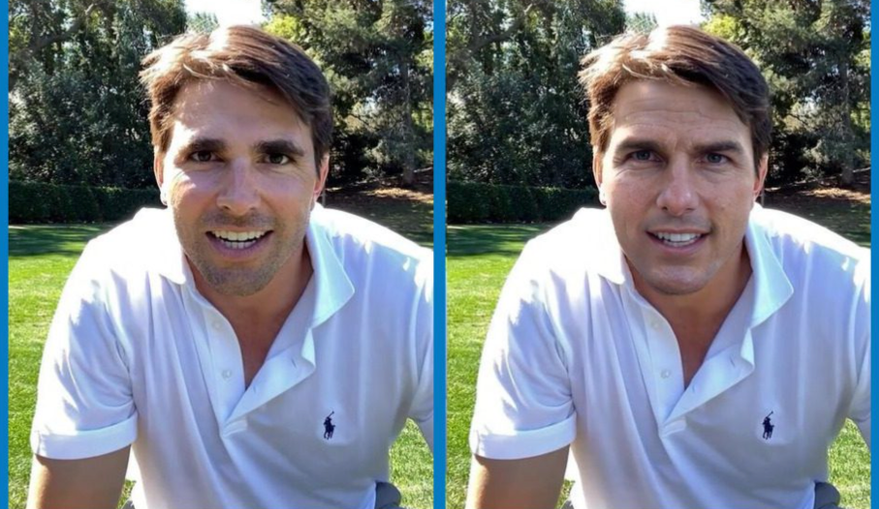

In the following two images, one is real and the other is generated by Deepfake. Have a guess!
We can find that the images generated are very realistic, with pores clearly visible and facial lighting.
Did you get it right?

Slide 6

David Beckham can “speak” nine languages! Using Deepfake

Slide 7
Deepfake is a double-edged sword.
Gather substantial attention both within academic circles and in the broader societal context due to its
Promising applications in computer vision and speech ☺
Related ethical and security & privacy implications.☹
Fraudsters used Deepfake to clone company director’s voice in $35 Million heist. – Reported by Forbes in 2021

Slide 8
Deepfake attacks

Slide 9
Deepfake attacks – Technical Background
Feature extractors
Convolutional Neural Networks (CNNs) on visual feature
Recurrent Neural Networks (RNN) on sequential feature
Domain knowledge: facial landmark, boundary conversion…
…
Generative models - AIGC
Generative Adversarial Networks (GANs)
Autoencoder (AE)
…
Learning/training strategy
Transfer Learning
Few-shot Learning
…

Slide 10
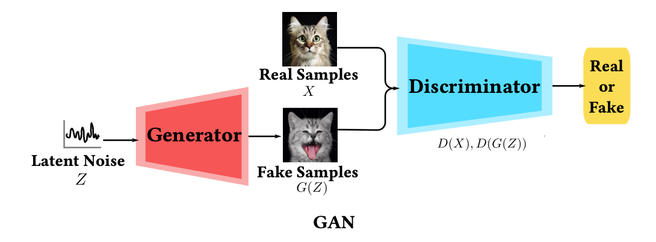
Generative Models – Generative Adversarial Networks (GAN)
GANs consist of two neural networks, the generator and the discriminator, engaged in a continuous adversarial training process.
Generator (G): generate fake data samples G(Z) from input latent noise Z that are indistinguishable from real data X.
Discriminator (D): differentiate between real and fake data samples. Typically, it is a binary classifier: (1 -> Real, 0 -> False).
Training: The two networks engage in a min-max game, where the generator seeks to minimize the discriminator‘s ability to differentiate fake G(Z) from real data X, while the discriminator aims to maximize its accuracy. This adversarial training process converges when the generator produces data G(Z) indistinguishable from real samples X.
GAN is the most prevailing generative model!
Zhang, C., Yu, S., Tian, Z., & Yu, J. J. (2023). Generative Adversarial Networks: A Survey on Attack and Defense Perspective. ACM Computing Surveys.

Slide 11
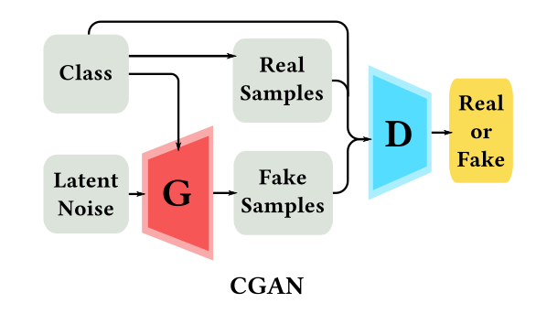
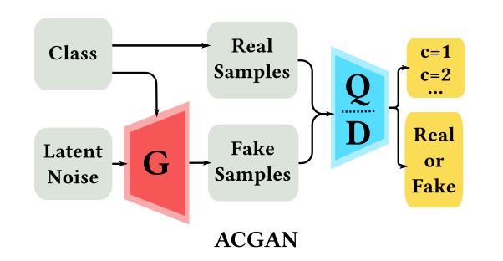
More powerful GANs - GANs’ variants
Conditional GAN (CGAN) introduces conditional information (e.g., class information) during the data generation process. CGAN enables to not solely generate data from random noise but incorporates additional conditional information. In this way, we can specify attributes (e.g., genders and species) in the sample generation.
Auxiliary Classifier GAN (ACGAN) introduces auxiliary classifiers into the GAN architecture. ACGAN providing a multi-task learning setup that not only generates realistic data but also enables to classify it into predefined categories.

Slide 12
Learning/training strategy
Transfer Learning - to achieve style transferring
One-to-one: A model that uses a specific identity to drive a specific identity.
Many-to-one: A model that uses many identities to drive a specific identity.
Many-to-many: A model that uses any identity to any identity.
Multi-modal source: A model use modal-A source (e.g., audio) to drive a model-B target (e.g., video).
Few-shot Learning - to handle lack of source samples
Pretrain + few samples fine tuning.
Contrastive learning

Slide 13
Practical Deepfake models can be compounded and orchestrated!

Slide 14
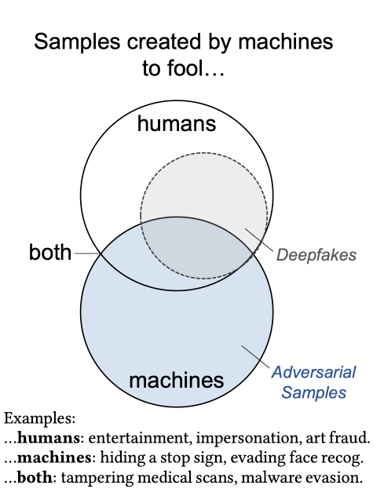
Facial deepfake: Deepfake attacks against human visuals
Two typical attacks:
Deepfake aims at confusing human-beings (Type I attack)
Adversarial samples aims to confuse machines (Type II attack)
Mirsky, Y., & Lee, W. (2021). The creation and detection of deepfakes: A survey. ACM Computing Surveys (CSUR), 54(1), 1-41.

Slide 15
Facial Deepfakes
Processes:
Replacement
Transfer (change the face of the identify completely)
Swap (infusion, change the face but keep some other attributes: expressions, gaze…)
Reenactment
Expression (angry, surprised..)
Mouth (e.g., David Beckham “speak” nine languages )
Gaze (stare at top ,at bottom ..)
Editing
Face color
Ethnicity
Synthesis
…
Threats:
Revenge porn, swaps a victim’s face onto the body of a porn actress to humiliate or blackmail the victim.
Impersonate a person to gain victims’ trust for scamming.
Fake profile photos
…

Slide 16
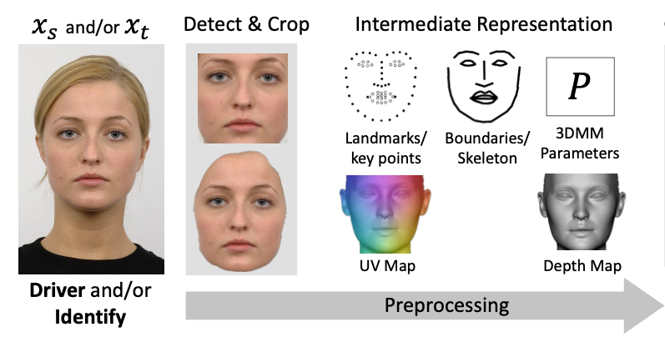
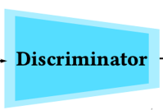



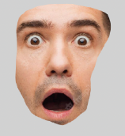
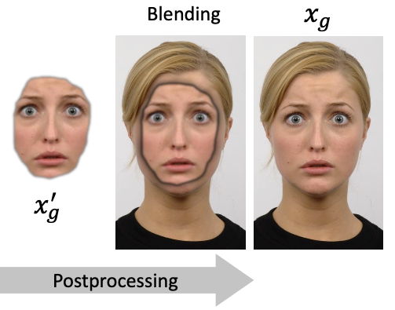
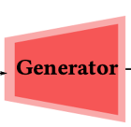
An illustration of facial expression swapping using GAN

Slide 17
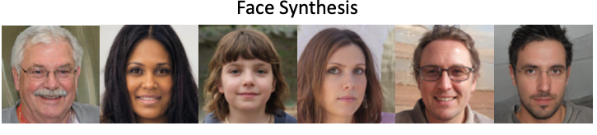
Portrait synthesis showcase
Try https://thispersondoesnotexist.com/: each time you refresh the page, you will get a generated fake portrait.

Slide 18
Deepfake countermeasures

Slide 19
Deepfake countermeasure - strategy
Detection (active defense)
Artifact-specific detection
Generic detection
Prevention (passive defense)
Data provenance
Adversarial machine learning

Slide 20
Detection (active defense)
Artifact-specific detection
- need domain knowledge:
Blending
Environment
Forensics
Behavior
Physiology
…
Generic detection
– no domain knowledge
Classification
Anomaly detection
Deepfakes often generate artifacts which maybe subtle to humans,
but can be easily detected using machine learning and forensic analysis

Slide 21
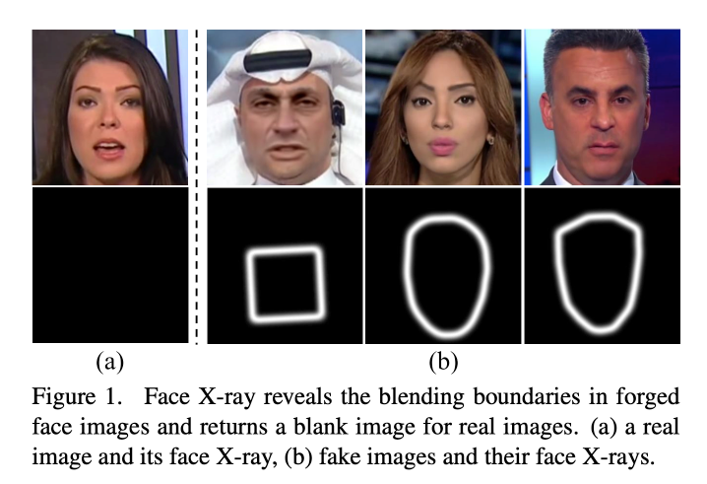
Detection (active defense) – a blending boundaries detection example
Face “X-ray” (a masking technique applied to the face image) can be used to detect both whether the image is fake and the blending boundaries of fake images.
Li, L., Bao, J., Zhang, T., Yang, H., Chen, D., Wen, F., & Guo, B. (2020). Face x-ray for more general face forgery detection. In Proceedings of the IEEE/CVF conference on computer vision and pattern recognition (pp. 5001-5010).

Slide 22
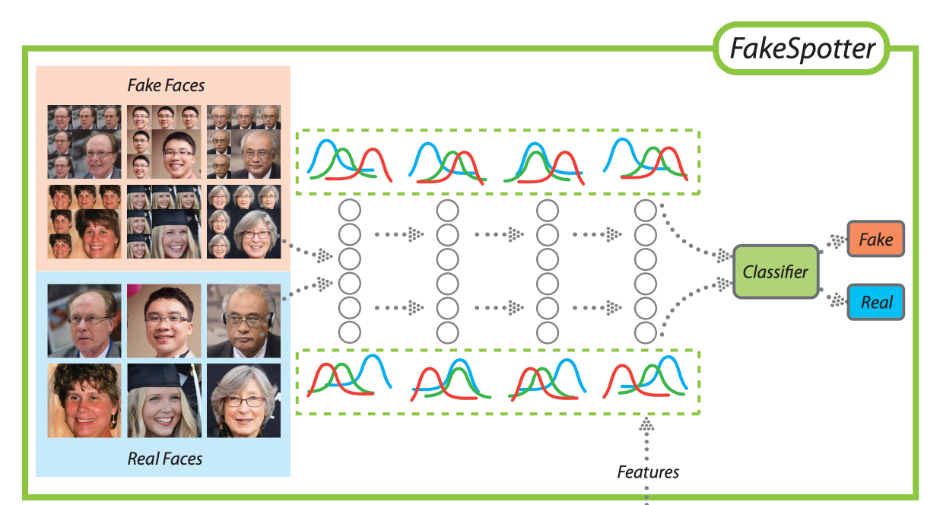
Detection (active defense) – a model anomaly detection example
Monitor the neuron behaviors to identify synthesized fake faces.
Wang, R., Ma, L., Juefei-Xu, F., Xie, X., Wang, J., & Liu, Y. Fakespotter: A simple baseline for spotting ai-synthesized fake faces. arXiv 2019. arXiv preprint arXiv:1909.06122.

Slide 23
Prevention (passive defense)
Adversarial machine learning
Focusing on protecting data privacy, we can also defend against Deepfakes in a passive way.

Slide 24
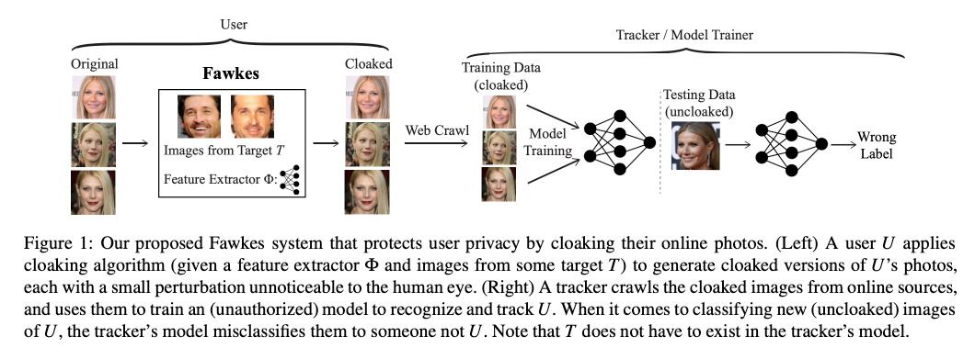
Prevention (passive defense) – an adversarial perturbation-based source data protection example
Shan, S., Wenger, E., Zhang, J., Li, H., Zheng, H., & Zhao, B. Y. (2020). Fawkes: Protecting privacy against unauthorized deep learning models. In 29th USENIX security symposium (USENIX Security 20) (pp. 1589-1604).
The adversarial perturbation can be unnoticeable to the human eye but effective to mislead the model, i.e., lead model to Type II error.

Slide 25

Deepfake Detection- Theoretical
Authentic or AI generated ?

Slide 26
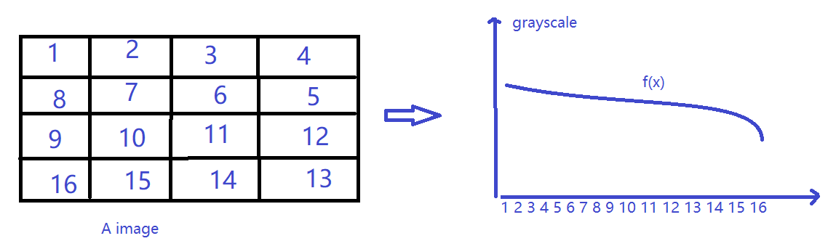
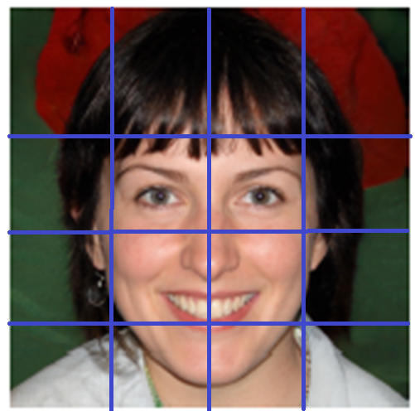
Methodology: Parameterized Curves
Transforming geometry to algebra

Slide 27
Deepfake Detection - Theoretical
Authentic AI generated
AI generated one is more “smooth” given the mechanism of CNN ?

Slide 28
Gradient and Curvature
First order derivative of f(x) – gradient at x
Second order derivative of f(x) – curvature at x

Slide 29
Reference and Resources
Karras, T., Laine, S., & Aila, T. (2019). A style-based generator architecture for generative adversarial networks. In Proceedings of the IEEE/CVF conference on computer vision and pattern recognition (pp. 4401-4410).
Li, L., Bao, J., Zhang, T., Yang, H., Chen, D., Wen, F., & Guo, B. (2020). Face x-ray for more general face forgery detection. In Proceedings of the IEEE/CVF conference on computer vision and pattern recognition (pp. 5001-5010).
Wang, R., Ma, L., Juefei-Xu, F., Xie, X., Wang, J., & Liu, Y. Fakespotter: A simple baseline for spotting ai-synthesized fake faces. arXiv 2019. arXiv preprint arXiv:1909.06122.
Shan, S., Wenger, E., Zhang, J., Li, H., Zheng, H., & Zhao, B. Y. (2020). Fawkes: Protecting privacy against unauthorized deep learning models. In 29th USENIX security symposium (USENIX Security 20) (pp. 1589-1604).
Mirsky, Y., & Lee, W. (2021). The creation and detection of deepfakes: A survey. ACM Computing Surveys (CSUR), 54(1), 1-41.
Zhang, C., Yu, S., Tian, Z., & Yu, J. J. (2023). Generative Adversarial Networks: A Survey on Attack and Defense Perspective. ACM Computing Surveys.
https://discuss.pytorch.org/t/cnn-lstm-implementation-for-video-classification/52018/10

